Slide 1
PatchFusion: An End-to-End Tile-Based Framework for High-Resolution Monocular Metric Depth Estimation
Zhenyu Li
zhenyu.li.1@kaust.edu.sa
Abstract: Single image depth estimation is a foundational task in computer vision and generative modeling. However, prevailing depth estimation models grapple with accommodating the increasing resolutions commonplace in today’s consumer cameras and devices. Existing high resolution strategies show promise, but they often face limitations, ranging from error propagation to the loss of high frequency details. We present PatchFusion, a novel tile based framework with three key components to improve the current state of the art.
PubDate：4 Dec 2023 Subject: Computer Vision and Pattern Recognition(CVPR 2024)
Notes:
(ˉ▽ˉ；)…

Slide 2
The Core Problem
当下的深度估计(SIDE)模型在各个领域都取得了很大的进展，如结合相对深度来预测绝对深度且具有Zero-Shot的ZoeDepth[1]，结合了文字描述来估计深度的Wordepth[3].
但它们还有一个缺陷，就是深度图的预测是在低分辨率的条件下进行的，如当前在SIDE领域的Sota: ZoeDepth输入图像的分辨率仅为384×512，其次的VPD[2]为480×480.
与现在的民用相机相比，这些数字相形见绌；例如45MP的Canon EOS R5，或是拥有15MP超广角镜头的iPhone 15.
基于此，本文提出了PatchFusion，旨在提供一种可以对超高分辨率图像进行实际深度距离估计的端到端模型(Metric Aware).
[1] Shariq Farooq Bhat. Zoedepth: Zero-shot trans fer by combining relative and metric depth
[2] Wenliang Zhao. Unleashing text-to-image diffusion models for visual perception. (ICCV 2023)
[3] Ziyao Zeng . Wordepth: Variational language prior for monocular depth estimation

Slide 3

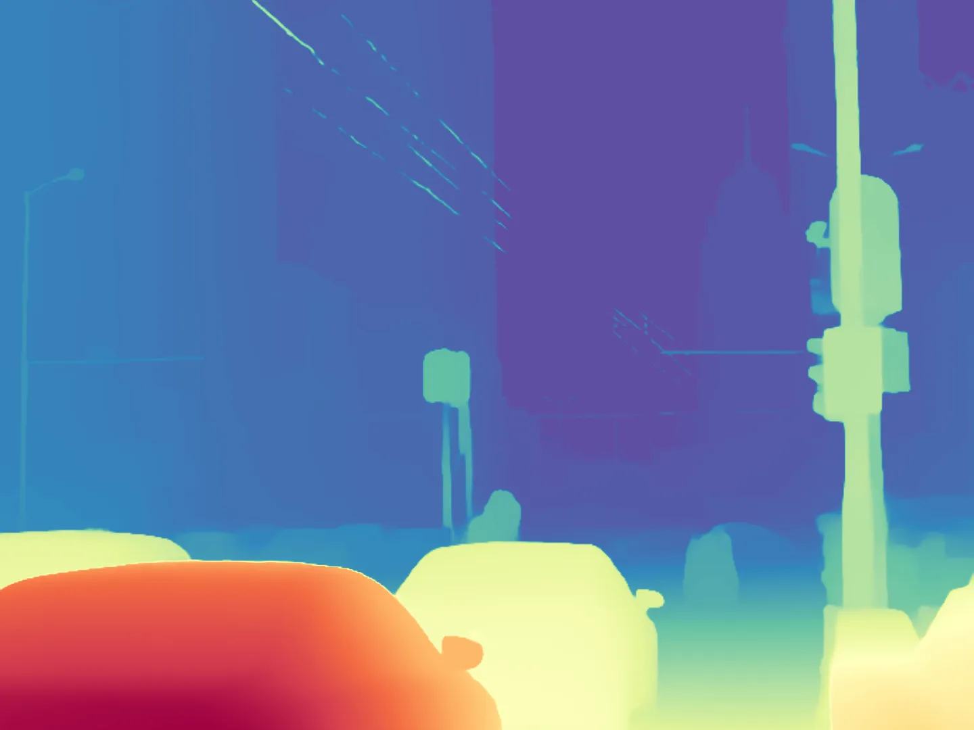








Clear Preview
global depth
fusion
local depth

Slide 4
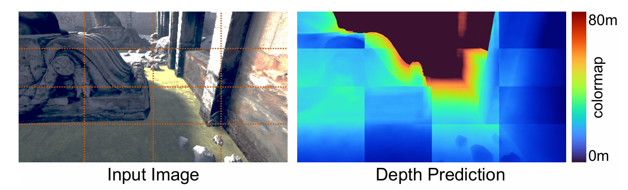
Problem

Slide 5
I. G2L Module

Slide 6
I. Guided Fusion Network

Slide 7
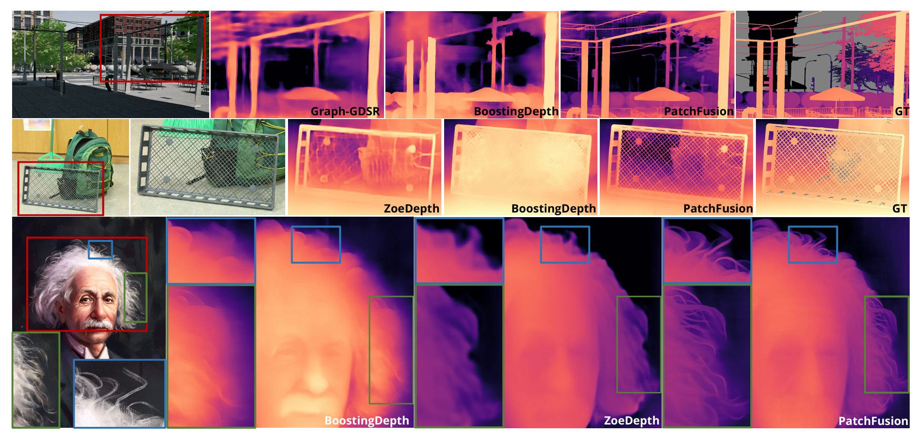
Result Preview

Slide 8
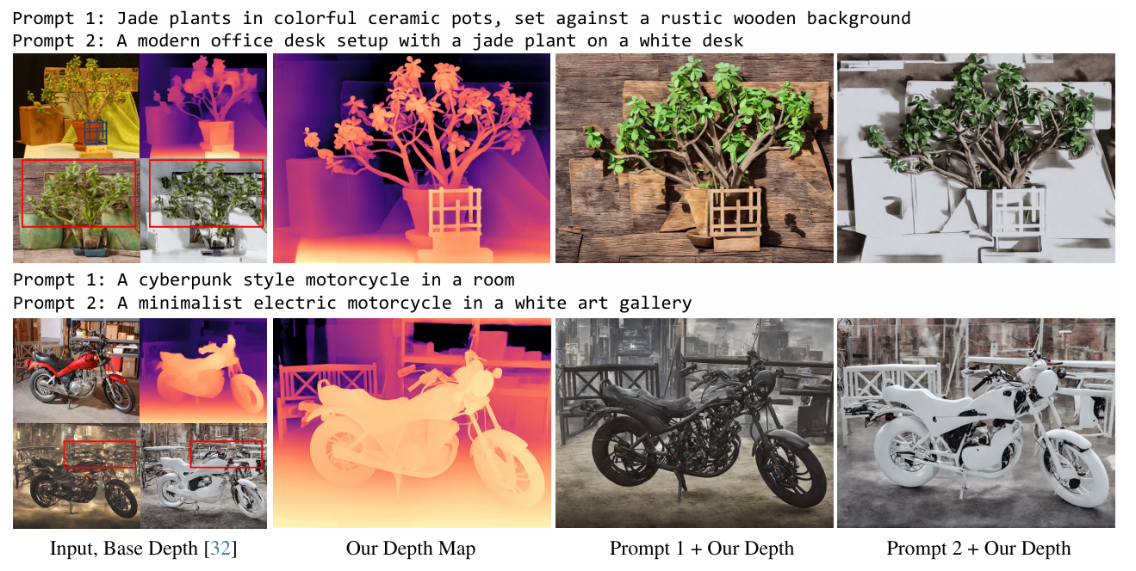

Slide 9
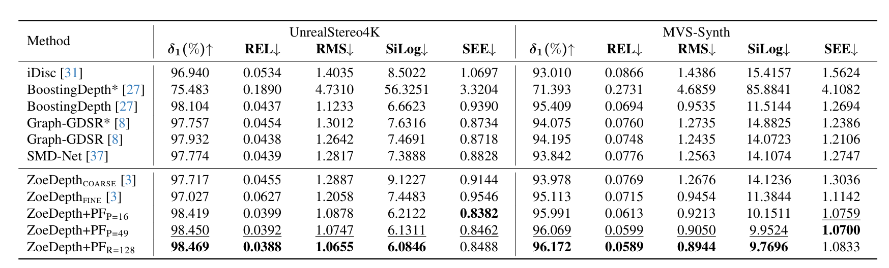

Slide 10
Limitation
虽然本框架在SIDE ＆ High-Res领域取得了不错的结果，该框架仅依赖于通过网络的正向传递，并且无需额外的预处理和后处理. 同时决定性地改进了UnrealStereo4K（RMSE 中为 17.3%）和MVS-Synth（RMSE 中为 29.4%）的基线模型，同时在零镜头传输中表现出令人满意的性能。但缺陷也是很明显
图像分割的块数越多，最终呈现的结果也是越好；但块数增多的同时也限制了框架的计算效率.
高分辨率的训练集在当下是较为稀少的，因此训练出的模型效果必然也会较差一些
UnrealStereo4K数据集中并没有包含很多均匀前景的图像，必然也会对训练结果产生影响
[1] Fabio Tosi, Yiyi Liao, Carolin Schmitt, and Andreas Geiger. Smd-nets: Stereo mixture density networks. In CVPR, pages 8942–8952, 2021

Slide 11
Thanks for Watching
E-mail: haruko386@outlook.com
Date: 2024/12/14

